Slide 1


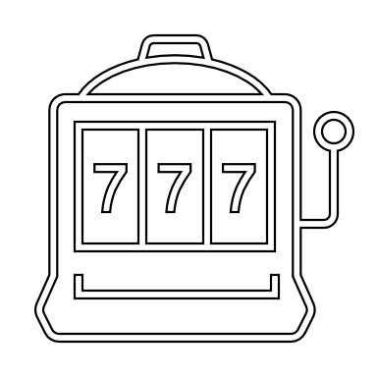
SLOT MACHINE 3000
BY: Alexandro Martinez
A fun game that simulates a slot machine, Play to win big money!!!

